Slide 1
Transition HPE BladeSystem to HPE Synergy

Slide 2
Four reasons to migrate to Synergy now
One Infrastructure to run any workload
More fluid pools of compute, storage, and fabric
Simpler Operations
Software defined intelligence advances
Superior Economics Lower TCO through CapEx and OpEx savings
Designed for the Future
With Investment Protection in mind

Slide 3
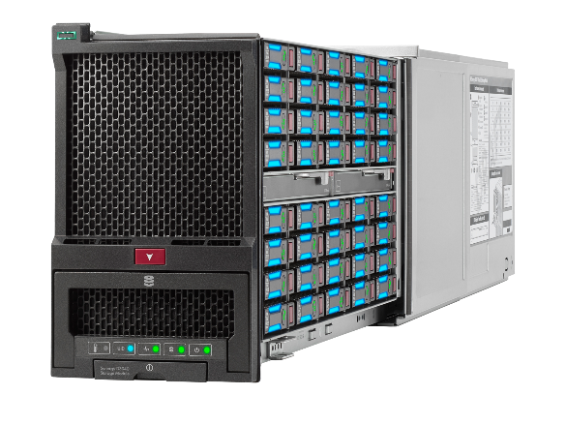
Enable broader set of applications at lower costs
More Fluid Pools of Compute, Storage, and Fabric
More Powerful Compute
Shared DAS Storage
Rack-scale Fabric
28-core/205W CPUs
50% more DIMMs; 3X more with EX
Deliver more application horsepower
Up to 202 shareable drives per compute
Enable storage-oriented applications (e.g. HPE StoreVirtual, VMware vSAN)
Connect 3.8x more compute to a single flat fabric
2.5x increased bandwidth
Improve north-south and east-west traffic performance and reduce cabling
29% lower $/VM
Up to 14X more storage
per server
$37K Uplink port saving
per rack
Notes:
Synergy makes significant enhancements in the raw resources (compute, storage, and fabric) compared to BladeSystem. These enhancements translate into more horsepower and more storage for your applications.
More Powerful Compute:
HPE Synergy 2-socket SY 480 Gen10 includes:
Support for full range of current and future Intel processors without any constraints or limitations. BladeSystem does not support processors greater than 150W and those to 28-core.
24 DIMM sockets (across all processors) compared to 16 in BladeSystem (only to 150W processors) enabling more memory for applications.
With Intel Xeon EX based compute modules memory DIMM slots gain a 3X advantage compared to Intel EP. Example: BL460c Gen10 has 16 DIMM capacity vs SY620 Gen10 has a 48 DIMM capacity
3 interchangeable mezzanine cards vs. 2 interchangeable ones in BladeSystem. (BladeSystem has a dedicated mezzanine for the onboard NIC).
Synergy has a broad range of 2 and 4 socket processor compute. BladeSystem has a reduced set of server choices.
29% lower $/VM based on a typical Synergy 480 Gen10 versus BladeSystem BL460c Gen10 compare – see the backup slide section for more detail.
Shared DAS Storage:
More flexible storage options, ranging from no storage (and no controller) to 4 SSD disks internally. Additionally the same RAID controller can be used for both disks internal to Synergy and in the Shared DAS storage module. BladeSystem requires two storage controllers to control both internal disks and disks in the side car storage blade.
Synergy storage module is shareable across the entire frame, BladeSystem storage module only works with adjacent blade.
Synergy can map up to 202 disks per compute versus 14 on BladeSystem, enabling more affordable storage options with 14X more storage per server.
202 drives per Synergy compute (2 per SY 480 Gen10 Compute Module + 200 per five D3940 Storage Modules each at 40 drives) versus 14 drives per BladeSystem server (2 per BL460c Gen9 Server Blade + 12 per BladeSystem D2220sb Storage Blade); 202/14 = 14.4.
Rack-scale Fabric:
Synergy fabric is rack-scale master switch/satellite interconnect architecture (3 frames at 50Gb and 20Gb, 5 frames at 10Gb). BladeSystem fabric options are single enclosure only necessitating switches in all enclosures, requiring more uplinks to datacenter network. Synergy reduces cabling and network ports due to master-satellite architecture.
3.8x more compute to a single flat fabric based on 16 BladeSystem servers versus 60 Synergy compute per pair of fabric switches.
2.5x increased bandwidth based on 3x 20Gb downlink/40Gb uplink fabrics on BladeSystem versus 3x 50Gb downlink/100Gb uplink fabrics on Synergy.
Uplink savings based on 16 less uplinks (4 for Synergy vs 20 for BladeSystem) at 2 uplinks per a switch for a 5-frame configuration. Assumes a managed data center network switch 40Gb per port at a list price of $2,419 and a 40G QSFP+ to QSFP+ 5m Direct Attach Copper Cable (passive) at $499 list ($2,918 total savings per uplink x 16 uplinks) = $46,688/5 frames = $9,338/frame = $37,350/rack assuming 4 frame per rack.

Slide 4
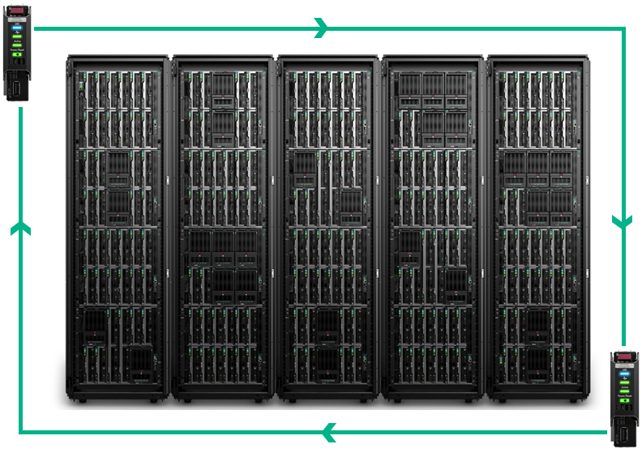
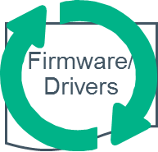
Simpler Operations
Software Defined Intelligence advances
Composer management
Simplified system update
Image Streamer
Single interface for up to 21 frames of compute, storage and fabric
Auto-discovery of all resources
Eliminates 99.8% of management touch points
Firmware downloadable in a single tested set
Server firmware activation can be aligned with application business needs
Up to 73% reduction in operator time performing firmware updates
Deploy, update, re-deploy physical machines like VMs
Stateless compute eliminates expensive of boot disks
Deploy Hypervisor and OS+Apps 80X faster than traditional network based deployments
Notes:
Synergy has several significant management enhancements compared to c-Class. The reduce operational time, complexity and expense. This comes from Synergy being developed to run at larger scale points and ready for a cloud world.
Composer:
Synergy does not require an external OneView instance to be configured, c-Class does. The composer houses OneView in it. It boots-up ready to run.
The Synergy management ring connects up to 21 frames together enabling the Composer to automatically discover and inventory all resources in the management ring. c-Class requires each enclosure to be manually discovered and imported into a OneView managed environment.
At 21 frames, a single composer manages up to 252 servers and associated fabrics. In contrast, c-Class requires direct management of all iLOs, Onboard Administrators, and Virtual Connect Managers. The reduction of all of these to a single interface is a 99.8% reduction in embedded management interfaces.
Simplified System Update
Firmware and driver updates has been a significant and growing challenge in the industry. Synergy has made significant strides in simplifying how firmware and drivers are updated.
Through MySPP, customers can create a custom Synergy SPP with all the latest, tested combination of firmware and drivers.
Firmware for a Logical Enclosure (3-5 frames, approximately one rack) can be updated through a single interaction. Firmware is then updated in a very orderly manner: first updating the shared management components and fabric modules and then pushing the firmware and drivers out of band into the iLOs of the compute nodes. Firmware and drivers are then staged on the server.
Server firmware and drivers are updated at the choosing of each server admin. Activation requires a reboot, but this can be aligned to desired windows such as an application maintenance window.
With this simplicity, admins can quickly perform the update operations, even compared to c-Class with OneView – up to 73% reduction in admin time. Compared to c-Class without OneView, the time savings are even greater.
On c-Class, one firmware update is done to a single enclosure with up to 16 servers. On Synergy, one firmware update can span up to 5 frames with 60 servers.
Image Streamer
Image Streamer enables stateless computing and very rapid provisioning, updating, and re-provisioning of servers. In effect, physical servers can be treated like Virtual Machines.
Individual compute nodes are stateless: no internal disks or RAID controllers are required. This results in initial acquisition cost savings and also reduces the number of parts that can fail.
Stateless servers can have new images created in seconds and booted with new personalities in a matter of minutes. This enables a variety of new paradigms such as rapid patching of images, or enabling nodes to change personalities over the course of a day in an HPC environment. In a hybrid environment, customers can shift the balance of servers running VMs or containers with ease.
80x faster due to 15 second image boot creation time vs 20 minutes without image streamer
Data per HPE internal testing of a HPE Synergy 480 Gen9 system with Image Streamer and embedded HPE One View compared to a HPE BladeSystem BL460c Gen9 system with HPE OneView, all compute installed with a VMware ESXi hypervisor.

Slide 5
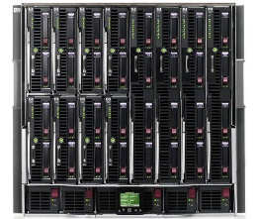
Synergy CapEx Savings
29% Lower Price per VM
HPE BladeSystem
BL460c Gen10
480Gb | LAN B/W per compute | 1.2Tb (+150%)
52 | Cores per compute | 56 (+8%)
16 | DIMMs per compute | 24 (+50%)
768 | DIMMs per rack | 864 (+12.5%)
4992 GHz | Compute cycles per rack | 5040 GHz (+1%)
96 | ISV licenses per rack | 72 (-25%)
96 | Boot disks | Image Streamer
12 | Network uplinks | 4 (-67%)
30U | space | 30U
18 | Power feeds | 18
HPE Synergy
SY 480 Gen10
Total price per VM advantage: 29%
Comparisons made at 3 frames with 2P compute.
Notes:
29% $/VM advantage details provided in backup slides.
LAN B/W (bandwidth) per compute: 3x 2-port 50Gb CNAs per SY 480 Gen10 (3 adapters x 50Gb speed x 2 ports x 2 for full duplex = 1200Gb = 1.2Tb) vs 3x 2-port20Gb CNAs per BL460c Gen10 (3 adapters x 20Gb speed x 2 ports x 2 for full duplex = 480Gb). (1200-480)/480 = 150% more.
Cores per compute: 2 Intel Xeon 28-core 8176 or 8180 processors per SY 480 Gen10 vs 2 Intel Xeon 26-core 8164 processors per BL460c Gen10. (56-52)/52 = 8% more.
DIMMs per compute: 24 DIMMs per SY 480 Gen10 vs 16 DIMMs per BL460c Gen10.
DIMMs per rack: 24 DIMMs per SY 480 Gen10 x 12 compute per frame x 3 frames per rack = 864 DIMMs per rack. 16 DIMMs per BL460c Gen10 x 16 compute per enclosure x 3 enclosures per rack = 758 DIMMs per rack. (864-768)/758 = 12.5% more.
Software licenses per rack: 2 VMware licenses per SY 480 Gen10 x 12 compute per frame x 3 frames per rack = 72 licenses per rack. 2 VMware licenses per BL460c Gen10 x 16 compute per frame x 3 frames per rack = 96 licenses per rack. (72-96)/96 = 25% less.
Boot disks: SY 480 Gen10 stateless per Image Streamer. 2 per BL460c Gen10 x 16 compute per frame x 3 frames per rack = 96 disks.
Network uplinks: 2 per Synergy interconnect switch x 2 switches per 3 frames-20Gb fabric = 4 uplinks. 2 per BladeSystem interconnect switch x 6 switches per 3 frames-20Gb fabric = 12 uplinks. (4-12)/12 = 67% less.
Rack space: 3 Synergy frames (30U total) vs 3 BladeSystem enclosures (30U total).
Power feeds: 3 Synergy frames x 6 power feeds/frame (18 total) vs 3 BladeSystem enclosures x 6 power feeds/enclosure (18 total).

Slide 6
Synergy Gen10 is optimized at scale vs BladeSystem @ 20Gb
Lower Price and TCO
Cost per Compute
Synergy
3.0% more
BladeSystem
1.7% less
5.7% less
6.0% less
TCO advantages
+
Notes:
This slide highlights typical Synergy acquisition price advantages versus BladeSystem at scale for configurations with a 20Gb fabric.
Similar results are expected with a 10Gb fabric.
These price advantages are primarily due to the:
HPE Synergy master-satellite fabric architecture at 2+ frames.
HPE Image Streamer stateless compute functionality at 3+ frames.
This slide’s conclusions are based on configurations with full HPE Synergy Frames (divided by the number of compute modules in those Frames) and compared with the values on a per compute basis. This configuration provides a balanced comparison, given that HPE Synergy Frames and BladeSystem enclosures support a different number of compute devices.
Pricing is net per US pricing in USD with a discount of 35% per Gartner Competitive Profiles based on the system cost of hardware and software for a typical mid-range configuration.
In this comparison, that configuration included:
Compute- 2P EP Gen10 level compute (SY 480 Gen10 for Synergy and BL460c Gen10 for BladeSystem) containing 2x 4116 processors and 16x16GB 2666 RDIMMs.
Image Deployment- Redundant Image Streamer solution with stateless compute for 3+ frames (Synergy), all others with 2x300GB SAS HDDs and hardware RAID controller.
Frame- Redundant power and fans.
Management-
Synergy: Embedded HPE OneView with iLO Adv, redundant HPE Composers, above mentioned redundant Image Streamer solution, and redundant Frame Link Models per frame (Synergy).
BladeSystem: HPE OneView with iLO Adv per server and redundant Onboard Administrators per enclosure.
Fabric- Redundant 20Gb:
Synergy: 3820C 20Gb CNA per compute and a redundant master-satellite architecture with 40Gb F8 VC Modules, 20Gb Interconnect Link Modules, and DAC interconnect link cables.
BladeSystem: 20Gb 650FLB CNA per server and redundant VC FlexFabric-20/40 F8 modules per enclosure.

Slide 7
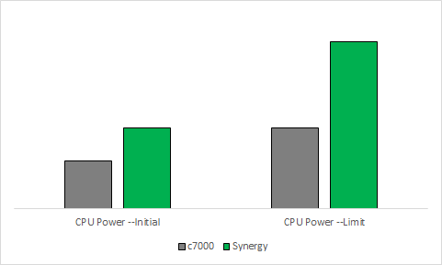
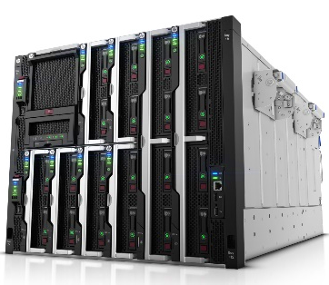
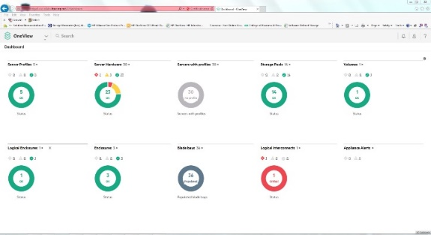
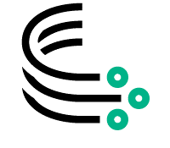
Designed for the future
Pathway to Cloud and The Machine
21X More Bandwidth
50% More Power Headroom
Extensible Management
Bandwidth of one Synergy optical connection is greater than total c7000 midplane
Synergy can grow its processors, c7000 processors are power-limited
Synergy can add new resource types and functions from the same UI and API
Deploy Hypervisor and OS+Apps
80X faster than traditional
network based deployments
100Gb enabled; Photonics and NVM Ready
Ready for Higher Power CPUs, GPUs, DIMMs and NVM
Ready to manage future
technologies and accept
advanced appliances
Notes:
Just like c-Class was designed in 2006 to be ready for the next 10 years, Synergy is designed now for the next decade of computing as well. Synergy is designed to handle both traditional application environments such as VMWare and MS applications, but also for new cloud-based and cloud-native applications developed in a DevOps environment. As computer architectures evolve to memory-driven computing with photonics and non-volatile memory (NVM), Synergy is ready for that too.
21X More Bandwidth
Each Synergy bay provides 3 redundant 100Gb links. This is 7.5X the bandwidth per bay of the c7000.
Synergy is further enabled with photonics-ready capabilities. Each bay is designed to support up to 12.8TB/s of photonic bandwidth. c-Class has no such capability. This will enable photonic connectivity between compute and NVM in the evolving memory-driven computing world and The Machine.
50% More Power Headroom
Synergy allocates more raw power per bay with 12 bays instead of 16 in Synergy. Further, Synergy has new advanced power management algorithms to take even better advantage of power allocated.
Intel processors are dramatically increasing power requirements. Synergy is designed to support these higher wattage processors
GPUs, which did not exist 10 years ago, are increasingly popular for VDI and high performance computing environments. Synergy is designed with ample headroom for these.
As storage moves more to solid state and NVM, the power density of storage is increasing, thus needing more power headroom.
Extensible Management
As computing evolves towards more abstracted, cloud based computing, management of infrastructure will need to evolve too. Also, as NVM becomes a shareable resource, it too will need to be managed. Traditional management approaches would simply create yet another management widget to manage yet another resource type. Synergy Composer, powered by OneView with the Unified API is designed to be highly extensible and ready for these futures, without the need to create more management tools.
Synergy with the Unified API essentially provides a Bare Metal as a Service. This integrates seamlessly with various cloud stacks and configuration management tools, making Synergy a fluid cloud underlay for current and future cloud states based on VMs, containers, or whatever else may be invented.
Synergy’s resource manager architecture enables future resource types such as NVM to be added and seamlessly managed the same as existing resource types.
Even the Unified API is extensible. It maintains backwards compatibility as it evolves forward in functionality, so existing code can continue to operate.
With all these capabilities built in, Synergy is well poised as a single platform for current and future needs.

