Slide 1
UCS Aging Infrastructure
GPU Use Case Example
Steve Delphy

Slide 2
Note to presenters
Overview – Remove this slide before presenting
Per the included animation, please view this deck in slide presentation mode.
This deck provides a summary of Cisco UCS aging infrastructure highlighting three key limiting aspects (processor, power, and I/O scalability).
An example is provided how these limitations affect a graphics processing unit (GPU) application with the economic impact to the customer.
Speaker notes are included.

Slide 3
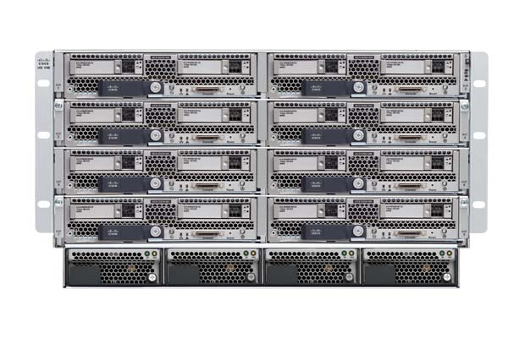
Architectural limitations with aging Cisco UCS infrastructure
Processor, memory, and fabric I/O demands are out stripping UCS 5108 chassis power
Limited I/O scalability, flexibility, and bandwidth
Cisco UCS
UCS specifications per the Cisco UCS B200 M5 Blade Server Spec Sheet, Rev A.14, December 15, 2017.
Notes:
UCS was introduced in March, 2009
Smartphones were the rage, flip phones were no longer hip.
The average internet connection speed was 3.6Mb, today it’s 521% faster
A 47” flat screen HDTV was about $4,000, it’s now less than $350
Facebook went global, Twitter became popular, and Microsoft introduced Bing
Processor, memory, and fabric I/O demands are out stripping UCS 5108 chassis power
Reduced chassis capacity to as little as 6 servers for mid to higher-end configurations
Limited I/O scalability, flexibility, and bandwidth
UCS with a single fabric (Ethernet/FCoE) vs Synergy at 3 independent fabrics (Ethernet/FCoE/FC)
A storage controller occupies one UCS mezzanine slot cutting UCS I/O scalability in half
UCS server bandwidth at 160Gb vs Synergy at 1,200Gb (full-duplex) with planned photonic capability
Uplink speeds limited to 40Gb, Synergy currently at 100Gb
UCS support only 1 I/O slot and no controller/local HDDs for CPUs >165W with potential reduced performance

Slide 4
UCS power limitations
HPE Synergy provides 2.1 times more power per bay
Vendor | Configuration | Available Power (N+N) | Power per GPU Bay* | HPE Synergy Advantage
HPE | Synergy 12000 | 7,950W | 1,325W | 2.1x
Cisco | UCS 5108 | 5,000W | 625W
* A “GPU Bay” is defined as the number of supported:
SY 480 Gen10 compute with MXM Expansion Module per Synergy 12000 Frame
B200 M5 servers per UCS 5108 Chassis.
UCS specifications per the Cisco UCS 5108 Blade Server Chassis, Rev A.16, November 6, 2017.
Notes:
This slide highlights how the aging UCS infrastructure provides limited power per compute bay.
HPE Synergy provides 2.1 times more power per GPU bay.

Slide 5
UCS power limitations (GPU example)
Up to 25% UCS chassis capacity reduction
Total Power Required (W)
2x 6136 CPUs, (3.0GHz/12C/150W), 24x 32GB RDIMMs, 2x HDDs, 2x NVIDIA P6 GPUs
2x 6150 CPUs, (2.7GHz/18C/165W), 24x 32GB RDIMMs, 2x HDDs, 2x NVIDIA P6 GPUs
2x 8168 CPUs, (2.7GHz/24C/205W), 24x 64GB RDIMMs, 1x NVIDIA P6 GPU, No HDDs (not supported)
Server Quantity
Source: UCS Power Calculator, January 8, 2018; see slide notes for system configuration details.
Note: The UCS Power Calculator maximum is 5,269W regardless if additional power requirements are added. See slide notes for additional information.
Notes:
This slide highlights how the aging UCS infrastructure with its limited power capacity affects the number of supported UCS servers per 5108 chassis.
Depending on the configuration, the 5108 is limited to only 6 servers, a 25% capacity reduction.
As such, you can think of the 5108 as a “5106”.
This 6 server limitation exists even with >165W CPU configurations supporting only one GPU and no local drives or storage controller.
UCS configuration:
5108 chassis with maximum 4x 5000W power supplies at N+N, 220 VAC input voltage, and 2x 2304 fabric interconnects.
B200 M5 blades with 1x 1340 mLOM.
Memory, processor, local drives (HDDs), and GPU(s) as indicated in the table. The drives are 300GB 12G SAS, 10K, 2.5” SFF.

Slide 6
UCS I/O scalability limitations (GPU example)
HPE Synergy provides up to a 223% GPU density advantage
2P Compute Configuration | GPUs per Compute | Compute per Frame | GPUs per Frame | Frame U Height | GPUs per U | HPE Synergy Advantage (GPUs per U)
HPE Synergy (All configurations) | 7 | 6 | 42 | 10 | 4.2
Cisco UCS Best Possible Software mirroring¹ | 2 | 8 | 16 | 6 | 2.0 | 56%
Cisco UCS Best Possible Hardware RAID² | 1 | 8 | 8 | 6 | 1.3 | 223%
Support for local M.2/SD drives with software mirroring (excluding VMware applications). Hardware RAID not supported as the 2 GPUs occupy all available I/O slots (i.e. there is no available slot for the required storage controller).
Requires a storage controller occupying one I/O slot limiting the UCS B200 M5 to just 1 GPU.
UCS specifications per the Cisco UCS B200 M5 Blade Server Spec Sheet, Rev A.14, December 15, 2017 and the Cisco UCS 5108 Blade Server Chassis, Rev A.16, November 6, 2017.
Notes:
This table highlights how the aging Cisco UCS infrastructure with its limited I/O scalability affects GPU density.
With only two interchangeable I/O slots, the best possible Cisco UCS B200 M5 density is merely 2 GPUs per B200 M5 server (16 per chassis) if software mirroring on local M.2 or SD drives (or boot from SAN) is acceptable.
The density is cut in half (only 1 GPU) if local HDD, SDD, or NVMe drives are desired as the required storage controller occupies one I/O slot.

Slide 7
UCS power AND I/O scalability limitations (GPU example)
HPE Synergy provides up to a 320% GPU density advantage
 | 2P Compute Configuration | GPUs per Compute | Compute per Frame | GPUs per Frame | Frame U Height | GPUs per U | HPE Synergy Advantage (GPUs per U)
 | HPE Synergy (All configurations) | 7 | 6 | 42 | 10 | 4.2
Software Mirroring¹ | Cisco UCS Best Possible | 2 | 8 | 16 | 6 | 2.7 | 56%
 | Cisco UCS Mid-range (≤165W CPUs) | 2 | 6⁵ | 12 | 6 | 2.0 | 110%
 | Cisco UCS High-end (>165W CPUs)³ | 1 | 6⁵ | 6 | 6 | 1.0 | 320%
Hardware RAID² | Cisco UCS Best Possible | 1 | 8 | 8 | 6 | 1.3 | 223%
 | Cisco UCS Mid-range (≤165W CPUs) | 1 | 6⁵ | 6 | 6 | 1.0 | 320%
 | Cisco UCS High-end (>165W CPUs)⁴ | 0 | 0 | 0 | 6 | 0 | N/A
Support for local M.2/SD drives with software mirroring (excluding VMware applications).
Requires a storage controller occupying one I/O slot limiting the UCS B200 M5 to just 1 GPU.
UCS B200 M5 configurations with >165W CPUs support only 1 GPU; performance may be impacted.
UCS B200 M5 configurations with >165W CPUs do not support local HDDs/storage controller/hardware RAID under any circumstance.
Based on the UCS Power Calculator for a 5,000W available N+N power configuration. See slide notes for additional details.
Notes:
This table highlights how the combination of the limited Cisco UCS power and I/O scalability affects GPU density even further.
Due to the limited power in the 5108 chassis, the already low “Best Possible” GPU density per the previous slide is reduced even further.
For UCS configurations with software mirroring (i.e. up to 2x GPUs per UCS server), the HPE Synergy advantage increases from 56% up to 320%.
For UCS configurations with hardware RAID mirroring (i.e. 1x GPU per UCS server), the HPE Synergy advantage increases from 223% to 320%.
Again by contrast, the HPE Synergy density is 7x GPUs per SY 480 Gen10 compute (42 GPUs per frame) and remains so for all configurations.
UCS configuration and specification notes:
UCS specifications per the Cisco UCS B200 M5 Blade Server Spec Sheet, Rev A.14, December 15, 2017 and the Cisco UCS 5108 Blade Server Chassis, Rev A.16, November 6, 2017.
UCS compute per frame values per the Cisco UCS Power Calculator January 8, 2018.
UCS “Mid-range “configuration (software mirroring): B200 M5 blades with 2x 6136 CPUs (3.0GHz/12C/150W), 24x 32GB RDIMMs, 1x 1340 mLOM, and 1x or 2x (as noted) NVIDIA P6 GPU card(s).
UCS “High-end” configuration (software mirroring): B200 M5 blades with 2x 8168 CPUs, (2.7GHz/24C/205W), 24x 32GB RDIMMs, 1x 1340 mLOM, and 1x NVIDIA P6 GPU card.
UCS “Mid-range” configuration (hardware RAID): B200 M5 blades with 2x 6136 CPUs (3.0GHz/12C/150W), 24x 32GB RDIMMs, 1x 1340 mLOM, 1x internal 1x UCSB-MRAID12G-HE controller with 2x 300GB 12G 10K SAS drives, and 1x NVIDIA P6 GPU card.
The UCSB-MRAID12G-HE controller power requirement was not available in the Cisco UCS Power Calculator; it was estimated at 8.4W per the HPE Smart Array P204i-SR Controller (804424-B21) power requirement.
All UCS configurations with the 5108 chassis with maximum 4x 5000W power supplies set at N+N, 220V AC input voltage, and 2x 2304 fabric interconnects.

Slide 8
Net system price per GPU user
HPE Synergy 480 Gen10: 3x GPUs/compute, stateless with HPE Image Streamer
UCS B200 M5: 1x GPU/server, local HDD drives w/ RAID controller
UCS B200 M5
1x P6 GPU/Server HW RAID Controller, 10Gb NIC
(No expansion available)
Net System Price (USD)
HPE SY 480 Gen10
3x P6 GPUs/Compute
Stateless, 10Gb NIC
(1 Controller / 1 I/O / 4 GPU expansion available)
GPU Users (@ 8 users per NVIDIA P6 GPU)
Pricing per Gartner IDEAS Competitive Profiles, Nov17 less discounts of 35% (HPE hardware), 60% (Cisco UCS hardware), 48% (HPE support) and 35% (Cisco UCS support).
Hardware discounts per Gartner IDEAS Competitive Profiles, January 2018. Support discounts per HPE Technical Services, May17-Jan18.
See slide notes for configuration details.
Notes:
This slide highlights how the aging UCS infrastructure with its limited I/O affects the net price per GPU.
The HPE Synergy configuration is at 3x P6 NVIDIA GPUs per stateless compute rather than the maximum of 7, plus one 10Gb NIC.
For advanced I/O and storage connectivity, HPE Synergy has an available mezzanine slot and one RAID storage controller slot (versus UCS that has none).
If 7 GPUs/compute were used, the HPE Synergy advantage would even be higher.
System configuration and pricing per the following (all with 2x processor cores and 32GB memory per user assuming 8 users per GPU):
HPE Synergy Compute:
SY 480 Gen10 with MXM Expansion Module, 2x 24-core 2.7GHz 8168 processors (48 cores total), 24x 32GB RDIMMs, 1x 2820C network adapter, 2x 300GB SAS 12G 10K drives + RAID storage controller (to 2 frames/12 nodes) and stateless compute with redundant HPE Image Streamer solution (3+ frames/13+ nodes), and 3x NVIDIA Tesla P6 GPUs.
Available I/O expansion (1x I/O mezzanine, 1x RAID storage controller, and 4x GPU).
Cisco UCS Servers:
B200 M5 with 1x 16-core 2.6GHz 6142 processor (16 cores total), 8x 32GB RDIMMs, 1x VIC 1340 mLOM network adapter, 2x 300GB SAS 12G 10K drives, 1x RAID storage controller, and 1x UCS Blade Server NVIDIA P6 GPU card.
No available mezzanine or other I/O expansion.
HPE Synergy Infrastructure
SY 12000 Frame at 6 compute per frame, N+N redundant power and fans, redundant FLMs and FLM cables, redundant master switch/satellite architecture with VC SE 40GB F8 switches, and 10Gb interconnect link modules with DAC cables.
Cisco UCS Infrastructure:
5108 Chassis at 8 servers per chassis, redundant N+N power, redundant 2304 FEXs each with 4 uplinks enabled with 40GBASE-CR4 3m passive copper cables, and redundant 6332 switches each with 4x enabled uplinks.
Management:
Cisco UCS with embedded UCS Manager, and UCS Central for configurations with >1 domain.
HPE Synergy with redundant HPE Composers with embedded HPE OneView with iLO Advanced.
Hardware Support:
HPE with 5-year 24x7, 4-hour response, HPE Foundation Care.
Cisco with Unified Computing Support Service, Onsite 5yr 24x7x4.

Slide 9
Net system price per GPU user
HPE Synergy 480 Gen10: 3x GPUs/compute, stateless with HPE Image Streamer
UCS B200 M5: 1x GPU/server, local HDD drives w/ RAID controller
@ 1,152 Users | HPE Synergy | Cisco UCS | HPE Savings
Frames | 4 | 24 | 83%
Compute | 48 | 144 | 67%
Mgmt Domains | 1 | 3 | 67%
Net Price (USD) | $2.7 million | $3.4 million | 23%
UCS B200 M5
1x P6 GPU/Server HW RAID Controller, 10Gb NIC
(No expansion available)
Net System Price (USD)
GPU Users (@ 8 users per NVIDIA P6 GPU)
Pricing per Gartner IDEAS Competitive Profiles, Nov17 less discounts of 35% (HPE hardware), 60% (Cisco UCS hardware), 48% (HPE support) and 35% (Cisco UCS support).
Hardware discounts per Gartner IDEAS Competitive Profiles, January 2018. Support discounts per HPE Technical Services, May17-Jan18.
See slide notes for configuration details.
Notes:
This slide highlights how HPE Synergy offers both a lowered CapEx and OpEx savings:
Lower CapEx via less frames, less compute, and less associated infrastructure to purchase and support.
Lower OpEx via a simpler system (less management domains, compute, frames, etc to install, deploy, manage, and maintain).
As show in the example, these savings can be significant.
System configuration and pricing per the previous slide.

Slide 10
Backup

Slide 11
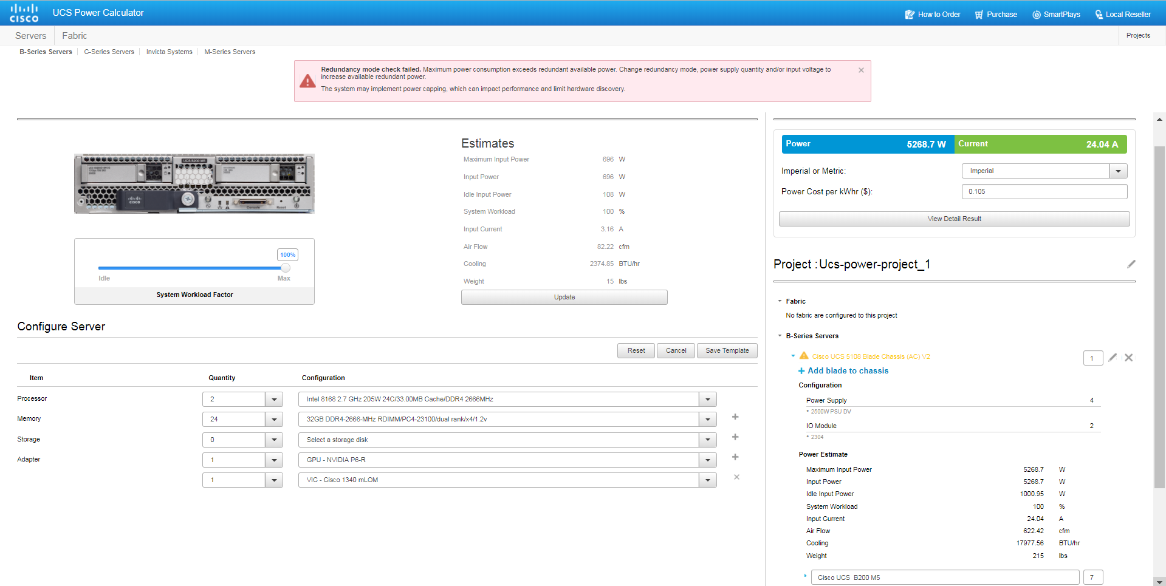
Up to 25% UCS 5108 server capacity reduction
Forced to go only 6 blades (25% capacity reduction)
5269W required vs 5000W available @ 7 blades
Source: UCS Power Calculator, January 8, 2018. See slide notes for additional information.
Notes:
UCS configuration:
5108 chassis with maximum 4x 5000W power supplies set at N+N, 220 VAC input voltage, and 2x 2304 fabric interconnects.
7x B200 M5 blades each with 2x 8168 processors, 24x 32GB DDR4-2666-MHz RDIMMs, 1x 1340 mLOM, and 1x NVIDIA P6 GPU card.
Note: A storage controller with internal drives were not included. (Not Supported)

Slide 12
The UCS aging infrastructure
UCS was introduced in March, 2009
Smartphones were the rage, flip phones were no longer hip.
The average internet connection speed was 3.6Mb, today it’s 521% faster
A 47” flat screen HDTV was about $4,000, it’s now less than $350
Facebook went global, Twitter became popular, and Microsoft introduced Bing
Processor, memory, and fabric I/O demands are out stripping UCS 5108 chassis power
Reduced chassis capacity to as little as 6 servers for mid to higher-end configurations
Limited I/O scalability, flexibility, and bandwidth
UCS with a single fabric (Ethernet/FCoE) vs Synergy at 3 independent fabrics (Ethernet/FCoE/FC)
A storage controller occupies one UCS mezzanine slot cutting UCS I/O scalability in half
UCS server bandwidth at 160Gb vs Synergy at 1,200Gb (full-duplex) with planned photonic capability
Uplink speeds limited to 40Gb, Synergy currently at 100Gb
UCS support only 1 I/O slot and no controller/local HDDs for CPUs >165W with potential reduced performance
UCS specifications per the Cisco UCS B200 M5 Blade Server Spec Sheet, Rev A.14, December 15, 2017.

Slide 13
Thank you

