Slide 1

HPE Synergy: Simplifying Hybrid IT

Slide 2
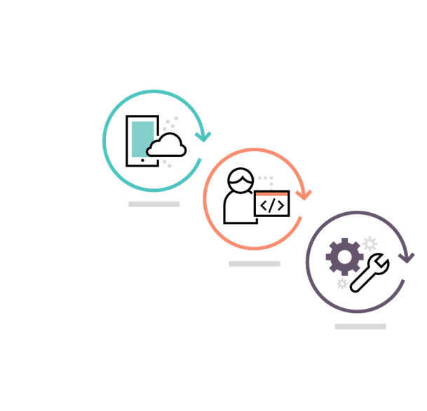
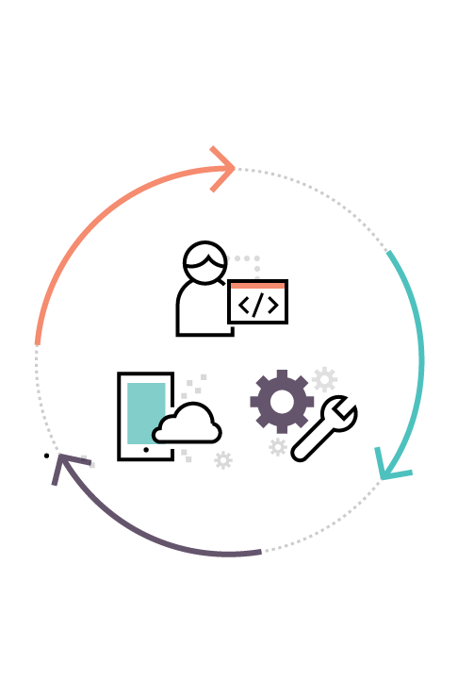
IT must support both traditional and new apps
Two infrastructure models are not sustainable
Traditional apps
Ops-driven
Cost-focused
Cloud apps
Apps-driven
Agility-focused
How can I support multiple models?
Traditional
IT
Private
clouds
Public
cloud 1
Private
clouds
Public
cloud 1
Public
cloud 2
Too complex
Too disconnected
Notes:
Key point: IT needs to meet the demands of the ideal economy while supporting traditional applications. Two infrastructure models are not sustainable because of increased complexity and costs. We need a single hybrid infrastructure that bridges the two worlds.
Meeting this challenge means leveraging the power of technology to quickly fuel the creative process and bring ideas to life. IT’s role must evolve from keeping the business running to accelerating time to business value. Although IT agrees with this new charter, it is difficult for them to deliver on these priorities as traditional infrastructure is optimized for stability, scalability, and performance but not for speed. In the Idea Economy, infrastructure must be the engine of value creation, not the bottleneck to success.
What has worked in the past isn’t going to work in the future, as IT must now be able to support two operating environments.
Traditional applications that are designed to support and automate existing business processes such as collaboration, data processing and analytics, supply chain, and web infrastructure.
A new breed of applications and services which drive revenue and new customer experiences by leveraging Mobility, Big Data, and Cloud Native technologies.
IT is being stretched in traditional environments to lower operating costs while at the same time being stretched in the new application environment to increase operational velocity.
--------------------------------------------------------------------------------
KEY TAKEAWAYS: Discuss the key challenge we’re hearing loud and clear that our customers are facing - bridging from traditional to the new style of business. They require the ability to do both. IT must be flexible to meet applications needs instantly.
Traditional: Customers find themselves with two modes of business that need to be addressed by IT and there’s nothing out there that allows them to do that with a single solution. From a tradition standpoint, we’re delivering technology solutions that are stable and allow customers to roll out applications and services in a very planned, longer term time frame. Support the business: Databases, OLTP, VMs (invisible)
New Style of Business : (Digital Enterprise, Digital Economy)
I.T. IS the business: Drives revenue/profit (mobile apps: res, bank)
With the emersion of cloud and other technologies, a new style of business is required, with more agility to do things more quickly to better drive more profitability into their organization agility
Our customers want to be relevant to and succeed at both
Our goal is to help them on the journey and to succeed at both
Discuss the key challenge in bridging from traditional to the new style: Bi-Modal
To help bridge, it would be great if one infrastructure could do both
To do that it would need to be able to flexibly change personalities
1) Reliable, low cost, secure
2) Agile, flexible, and fluid
Can’t be static, must take on different personas dynamically
Must be able to flex to what the application needs, not overprovision
There are fundamental differences in the tools and technologies required to run “traditional” and New Style of Business application workloads.
To meet both the different needs, companies are investing in two separate environments, which increases costs and complexity. Gartner calls this Bi-Modal computing
API proliferation, for example, with different or no APIs in traditional IT. And different API’s in new style of business.
We see a new class of infrastructure is needs which can Increase IT Efficiencies for Traditional Apps and enable Continuous Services Delvers for the New Style of Business

Slide 3
Extending our composable strategy to make Hybrid IT simple
Evolving from composing infrastructure to composing workloads across hybrid IT
Composing workloads across Hybrid IT
Fluid pools of VMs, containers, bare metal
and public clouds
Simple and consistent experience
Simplify building and managing software stacks
‘No-ops’ management
Pay-for-use consumption
Workload optimization
Simple
HPE OneSphere
Fluid
Composable Infrastructure
Applications optimized
Fast
Hyperconverged Infrastructure
Shared
Converged Infrastructure
Siloed
Traditional Infrastructure
Operations optimized
Notes:
18 months ago we launched our vision for composable infrastructure,
To deliver Hybrid 2.0 takes Innovation in HW and SW
Hybrid 2.0 = simplify everything, enables developers frictionless environment to run any app on any cloud and to provide developers as a service, containers as a service
Looking at the past couple of years, we have had Traditional Infrastructure that is siloed and can take months to stand up.
Then, we introduced Converged Infrastructure that is shared and where you can get to time to value in days.
Recent buzz has been a lot about Hyper-Converged which is indeed simpler and where you can go from power-on to provisioning virtual machines in minutes.
But what you really need is a Composable infrastructure that is fluid and is optimized to deliver infrastructure in seconds for both your traditional and new apps. Infrastructure for the Idea Economy.

Slide 4


Hybrid IT engine for your digital transformation
Empower IT to create and deliver value instantly and continuously
Run anything
Optimize all apps and
service-levels
Move faster
Accelerate app and service delivery
Work efficiently
Reduce operational effort
and cost
Unlock value
Increase productivity and control
When IT operations run faster, everything runs faster
Notes:
Accelerating business transformation; digital transformation
Key point: The idea economy puts new demands on IT infrastructure. You now need an infrastructure that empowers IT to create and deliver new value instantly and continuously.
Composable Infrastructure, offers an experience that empowers IT to create and deliver new value instantly and continuously enabling IT to:
Run anything: Optimize all apps and service levels
•Optimize any application, reduce CapEx and free resources with a single infrastructure with fluid pools of physical and virtual compute, storage, and fabric.
Move faster: Accelerate app and service delivery
Accelerate application and service delivery through a single interface that precisely composes logical infrastructures at near-instant speeds.
Work efficiently: Reduce operational effort and cost
Reduce operational effort and cost through internal software defined intelligence with template driven, frictionless operations.
Unlock value: Increase productivity and control
Increase productivity and control across the data center by integrating and automating infrastructure operations and applications through a unified API.
Technical description of Infrastructure as code
Provision bare metal infrastructure with one line of code – in the same way as virtual machines and cloud

Slide 5
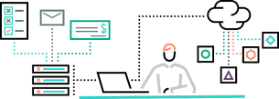
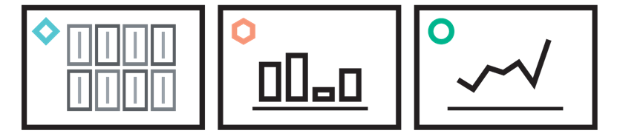

HPE Composable Infrastructure
Software-defined modern architecture
Unified API
  Single line of code to abstract every element of infrastructure
  Full infrastructure programmability
  Bare metal interface for Infrastructure as a Service
Composable infrastructure
Unified API
Fluid resource pools
Single infrastructure of disaggregated resource pools
Physical, virtual, and containers
Auto-integrating of resource capacity
Software-defined intelligence
Fluid resource pools
Software-defined intelligence
  Template-driven workload composition
  Non-disruptive, frictionless operations
Notes:
Fluid resource pools
Flexible resource pools of compute, storage, and fabric eliminate over-provisioning and stranded capacity. Resources are always available and can be instantly configured for any workload.
Software-defined intelligence
Software-defined intelligence enables high-level, automated operations, reducing complexity and manual tasks. Resources can be managed as a unit and dynamically allocated to meet the needs of any application.
Unified API
A unified API provides full programmability, so you can provision bare metal infrastructure with a single line of code, increasing operational efficiency and rapid deployment of IT resources.
Fluid Resource Pools
A single infrastructure with fluid pools of compute, storage, and fabric, so all the resources are now always available and can be instantly configured according to the specific needs of each application, reducing the need for costly infrastructure silos.
Single infrastructure of disaggregated pools of compute, storage and fabric that boots-up ready for any workload
Physical, virtual and containers
Auto-integrating of resource capacity
Software-Defined Intelligence
Internal software-defined intelligence with template driven, frictionless operations abstracts away the need for IT admins to understand operational minutiae of various hardware components replacing it with high-level, automated operations.
Template-driven workload composition
Frictionless operations
Unified API
The Unified API increases productivity and control across the data center by integrating and automating infrastructure operations and applications, eliminating time-consuming scripting of multiple varied low-level tools and interfaces.
Single line of code to abstract every element of infrastructure
Full infrastructure programmability
Bare metal interface for Infrastructure as a Service

Slide 6



Traditional infrastructure is static, complex and strands resources
Underutilized capacity
Negative ROI
  Preconfigured static physical IT or virtual IT
  Over-provisioned infrastructure
  Complexity and cost increased with growth
Notes:
So if we look at where we came from with traditional infrastructure we have a collection of kind of siloed products, we have servers, storage and networking products, and typically when you go deploy these things it’s very complex because you build up all these silos and you have to connect them all together, the process takes a long time and customers figure, well the last thing I want to do is do that again, so they tend to overprovision the infrastructure, sometimes it can be as much as 80% or 2X more than what is actually needed. And with that overprovisioning of course comes with additional cost as well so you spend a lot more CAPEX up front but then of course you have to keep that infrastructure maintained which means you spend more on OPEX over time as well. So what we do is we take that instead and replace it with fluid pools of compute, storage and fabric. What we do is take the essence of the server, storage, and networking and reduce it down to its bare elements, compute, storage, and fabric that can kind of start their lives as stateless and anonymous resources that can then be easily combined and configured to deliver to the needs of an application in a near instantaneous fashion. As more infrastructure is added in it’s auto-assembled with the existing infrastructure so it’s ready to go and just becomes part of the pool of capacity. Because it’s so easy to combine resources on the fly it really eliminates the need to so dramatically overprovision infrastructure, and instead allows infrastructure to be provisioned right sized and easily grown or shrunk as needed.

Slide 7


Composable Infrastructure optimizes all apps and service-levels
Fluid resource pools
Underutilized capacity
Negative ROI
Disaggregated pools of capacity
All resources needed to run any application are instantly available
Eliminate over-provisioning and stranded resources
Underutilized capacity
can now be removed
Fluid Resource Pools
Notes:
So if we look at where we came from with traditional infrastructure we have a collection of kind of siloed products, we have servers, storage and networking products, and typically when you go deploy these things it’s very complex because you build up all these silos and you have to connect them all together, the process takes a long time and customers figure, well the last thing I want to do is do that again, so they tend to overprovision the infrastructure, sometimes it can be as much as 80% or 2X more than what is actually needed. And with that overprovisioning of course comes with additional cost as well so you spend a lot more CAPEX up front but then of course you have to keep that infrastructure maintained which means you spend more on OPEX over time as well. So what we do is we take that instead and replace it with fluid pools of compute, storage and fabric. What we do is take the essence of the server, storage, and networking and reduce it down to its bare elements, compute, storage, and fabric that can kind of start their lives as stateless and anonymous resources that can then be easily combined and configured to deliver to the needs of an application in a near instantaneous fashion. As more infrastructure is added in it’s auto-assembled with the existing infrastructure so it’s ready to go and just becomes part of the pool of capacity. Because it’s so easy to combine resources on the fly it really eliminates the need to so dramatically overprovision infrastructure, and instead allows infrastructure to be provisioned right sized and easily grown or shrunk as needed.

Slide 8






Traditional infrastructure is complex with multiple silos and tools
  Software layered on top to mask complexity
  Hardware templates
  Complex lifecycle management, interdependencies and downtime
Notes:
HPE Synergy enables IT to accelerate application and service delivery through a single interface that precisely composes and recomposes logical infrastructures into any combination at near-instant speeds. Composable resources are provisioned together with their state (bios settings, firmware, drivers, protocols, etc.) and the Operating System image using repeatable templates. This is ideal for traditional IT as well as DevOps approach as it eliminates time-consuming provisioning processes across operational silos that often delay projects for weeks or months. With
HPE Synergy reduces operational effort and cost through internal software defined intelligence with template driven, frictionless operations. Templates define how the infrastructure needs to function, and the infrastructure’s internal software defined intelligence implements the needed changes programmatically without human intervention.
This changes the paradigm of how infrastructure is managed. Historically, change operations required coordination across multiple teams, multiple tools and complex interdependent processes that can often take weeks to complete. HPE Synergy abstracts away operational minutia replacing it with high-level, automated operations. Now, change operations such as updating firmware, adding additional storage to a service, or modifying network connectivity are automatically implemented via a template, significantly reducing manual interaction and human error. This empowers IT to configure the entire infrastructure for development, testing, and production environments using one interface and in one step with precision, accuracy, and speed.

Slide 9


Composable Infrastructure accelerates service delivery and reduces operational effort
Fluid resource pools
Software-Defined intelligence
Single management interface integrates silos
Integrated intelligence eliminates complexity
Workload templates speed deployment
Frictionless operations eliminate unnecessary downtime
Software-defined Intelligence
Fluid Resource Pools
Notes:
HPE Synergy enables IT to accelerate application and service delivery through a single interface that precisely composes and recomposes logical infrastructures into any combination at near-instant speeds. Composable resources are provisioned together with their state (bios settings, firmware, drivers, protocols, etc.) and the Operating System image using repeatable templates. This is ideal for traditional IT as well as DevOps approach as it eliminates time-consuming provisioning processes across operational silos that often delay projects for weeks or months. With
HPE Synergy reduces operational effort and cost through internal software defined intelligence with template driven, frictionless operations. Templates define how the infrastructure needs to function, and the infrastructure’s internal software defined intelligence implements the needed changes programmatically without human intervention.
This changes the paradigm of how infrastructure is managed. Historically, change operations required coordination across multiple teams, multiple tools and complex interdependent processes that can often take weeks to complete. HPE Synergy abstracts away operational minutia replacing it with high-level, automated operations. Now, change operations such as updating firmware, adding additional storage to a service, or modifying network connectivity are automatically implemented via a template, significantly reducing manual interaction and human error. This empowers IT to configure the entire infrastructure for development, testing, and production environments using one interface and in one step with precision, accuracy, and speed.

Slide 10
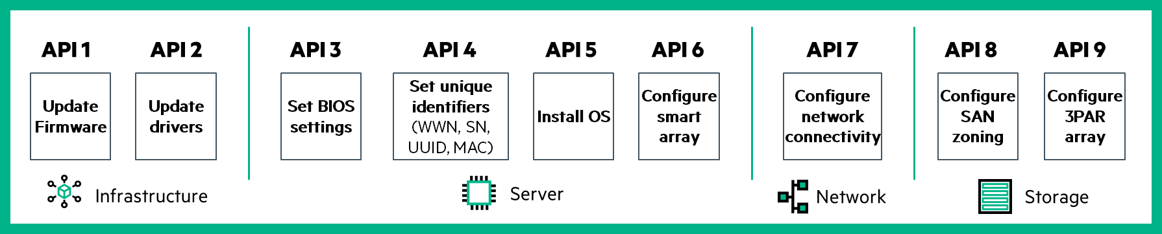
Automating Traditional Infrastructure is complex and time consuming
    Multiple APIs
    Proprietary management tools
    Months to provision applications
Composable Infrastructure
Notes:
HPE Synergy increases productivity and control across the data center by integrating and automating infrastructure operations and applications through a unified API. The unified API provides a single interface to discover, search, inventory, configure, provision, update, and diagnose the composable infrastructure. A single line of code fully describes and can provision the infrastructure required for an application, eliminating time-consuming scripting of more than 500 calls to low-level tools and interfaces.
In traditional environments, IT can now automate their IT operational processes and design their workflow around enterprise needs. For the new breed of applications, DevOps can now automate applications through infrastructure deployment, scaling, and updates. The unified API aggregates physical resources in the same way as virtual and public cloud resources, so developers can code without needing a detailed understanding of the underlying physical elements.
This fully programmable interface integrates into dozens of popular management tools such as Microsoft SystemsCenter®, Redhat®, and VMWare vCenter®, among others. It is also future proofed by integrating into open source automation and DevOps tools such as Chef, DockerTM, and OpenStack.

Slide 11



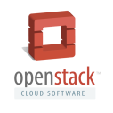
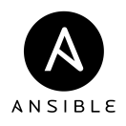

Composable Infrastructure increases productivity and control across the data center
Fluid resource pools
Fluid resource pools
Software-Defined intelligence
Software-defined intelligence
Composable Infrastructure
Unified API
Unified API
Single API for full infrastructure programmability
Open integration extends the power of the infrastructure across the data center
Seconds to provision and change
Unified API
Software-defined Intelligence
Fluid Resource Pools
Notes:
HPE Synergy increases productivity and control across the data center by integrating and automating infrastructure operations and applications through a unified API. The unified API provides a single interface to discover, search, inventory, configure, provision, update, and diagnose the composable infrastructure. A single line of code fully describes and can provision the infrastructure required for an application, eliminating time-consuming scripting of more than 500 calls to low-level tools and interfaces.
In traditional environments, IT can now automate their IT operational processes and design their workflow around enterprise needs. For the new breed of applications, DevOps can now automate applications through infrastructure deployment, scaling, and updates. The unified API aggregates physical resources in the same way as virtual and public cloud resources, so developers can code without needing a detailed understanding of the underlying physical elements.
This fully programmable interface integrates into dozens of popular management tools such as Microsoft SystemsCenter®, Redhat®, and VMWare vCenter®, among others. It is also future proofed by integrating into open source automation and DevOps tools such as Chef, DockerTM, and OpenStack.

Slide 12
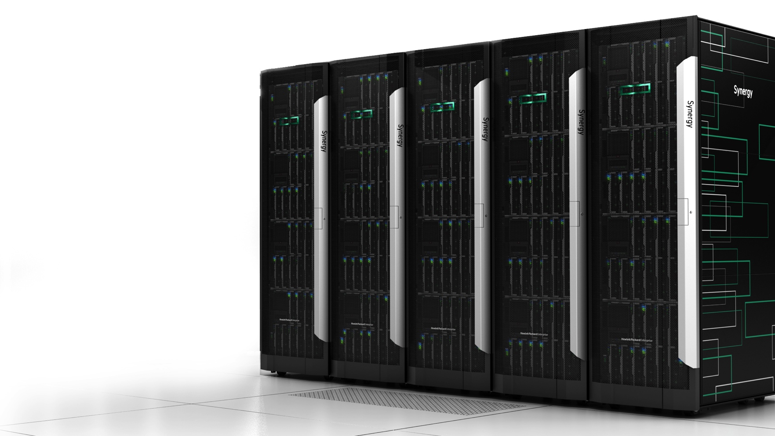

HPE Synergy: The first platform architected for composability
Your infrastructure as code
REDUCE
over-provisioning and CapEx
DEPLOY
at cloud-like speed
SIMPLIFY
with frictionless IT
DEVELOP
more apps, faster
Notes:
HPE Synergy - the industry's first true composable infrastructure!!
It consists of three defining elements:
Flexible resource pools of compute, storage, and fabric in one infrastructure.
Software-defined intelligence that allows these resources to be managed as one unit and dynamically allocated to the needs of the application.
And, a single API that allows ops and developers to access the resources as code.
Over the next part of this presentation, I am going to show you how HPE Synergy will help you -
Reduce over-provisioning and CAPEX
Deploy infrastructure at cloud-like speed
Simplify your operations with frictionless operations
and Develop more apps, faster

Slide 13
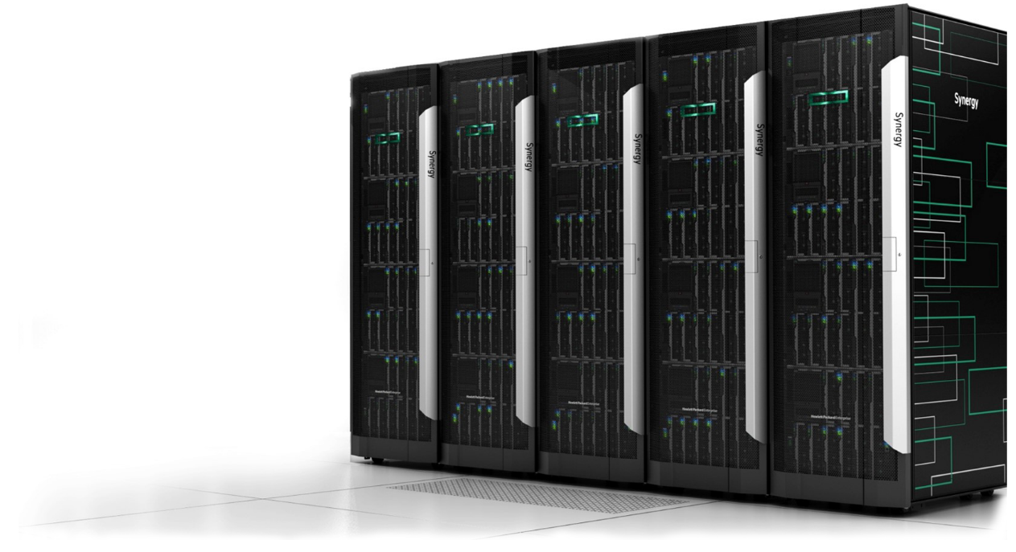


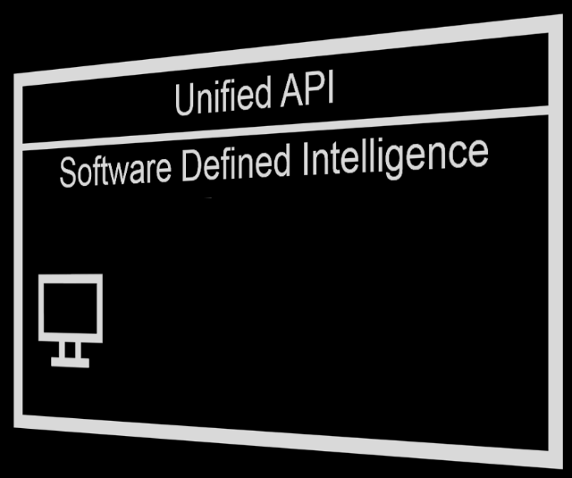

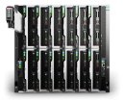

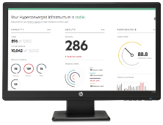
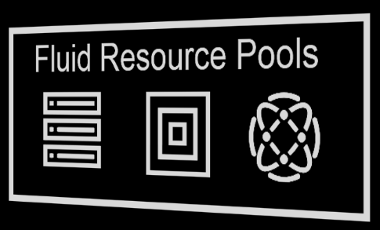
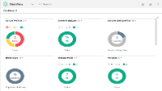
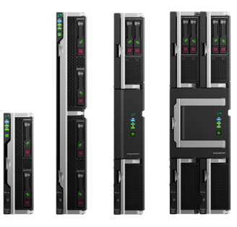
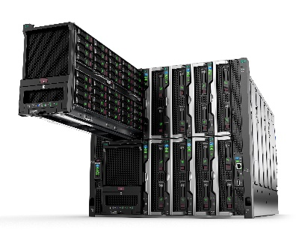

HPE Synergy: driving digital transformation in a Hybrid IT world
Composer powered by HPE OneView and
Image Streamer
Composable Fabric
Composable Compute
Composable Storage
Notes:
HPE Synergy, the first platform built from the ground up for Composable Infrastructure, offers an experience that empowers IT to create and deliver new value instantly and continuously. It is a single infrastructure that reduces operational complexity for traditional workloads and increases operational velocity for the new breed of applications and services. Through a single interface, HPE Synergy composes physical and virtual compute, storage, and fabric pools into any configuration for any application. As an extensible platform, it easily enables a broad range of applications and operational models such as virtualization, hybrid cloud, and DevOps. With HPE Synergy, IT can become not just the internal service provider but the business partner to rapidly launch new applications that become the business.

Slide 14
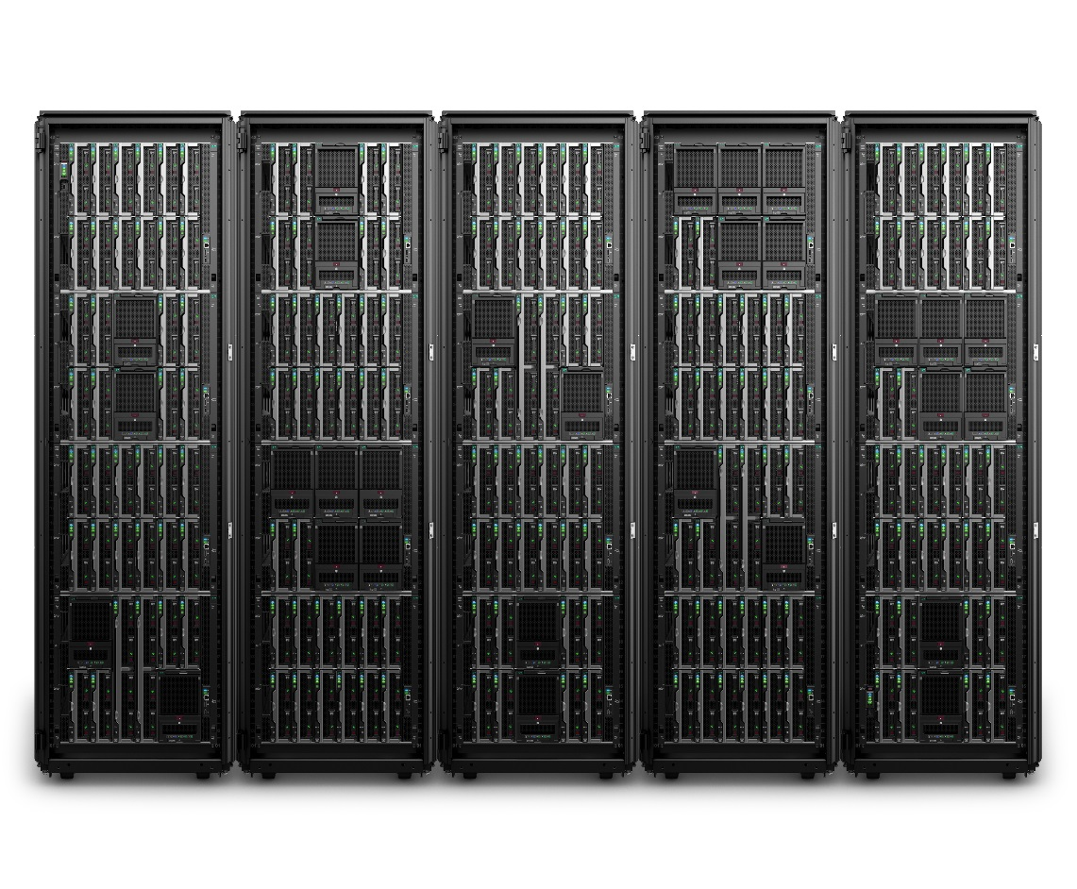
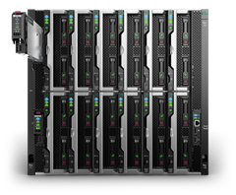
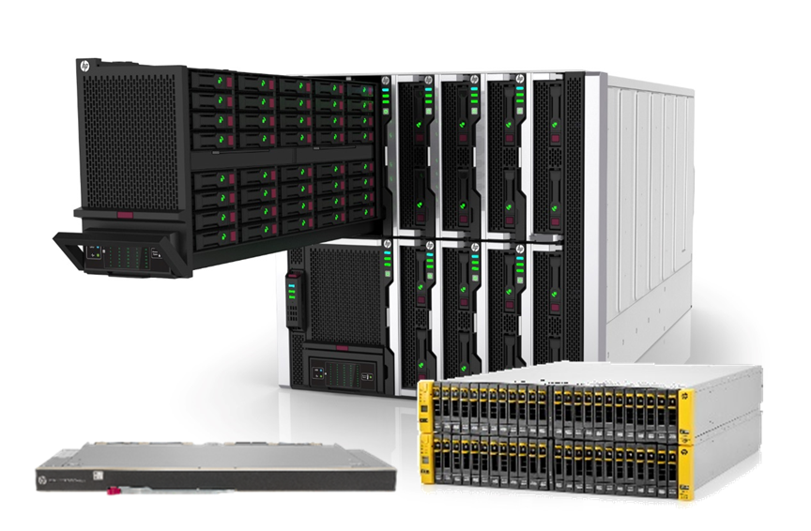
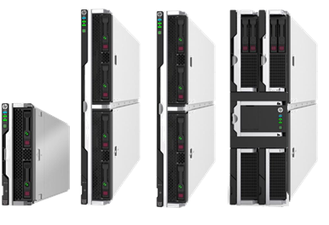
HPE Synergy: Powering your Hybrid IT transformation
  Composable Frame
  Everything needed to run applications, so IT can be quickly setup and consumed
  Auto-integrating makes scaling simple and automated at rack/row scale
Composer
Integrated software-defined intelligence to self-discover, auto-integrate, provision and scale from racks to rows
Composable Fabric
Rack scale multi-fabric connectivity eliminates standalone TOR switches
Composable Compute
Provides the performance, scalability, density optimization, storage simplicity, and configuration flexibility
Composable Storage
High-density integrated storage to compose any compute with any storage (SDS, DAS, SAN)
Notes:
HPE Synergy, the first platform built from the ground up for Composable Infrastructure, offers an experience that empowers IT to create and deliver new value instantly and continuously. It is a single infrastructure that reduces operational complexity for traditional workloads and increases operational velocity for the new breed of applications and services. Through a single interface, HPE Synergy composes physical and virtual compute, storage, and fabric pools into any configuration for any application. As an extensible platform, it easily enables a broad range of applications and operational models such as virtualization, hybrid cloud, and DevOps. With HPE Synergy, IT can become not just the internal service provider but the business partner to rapidly launch new applications that become the business.

Slide 15

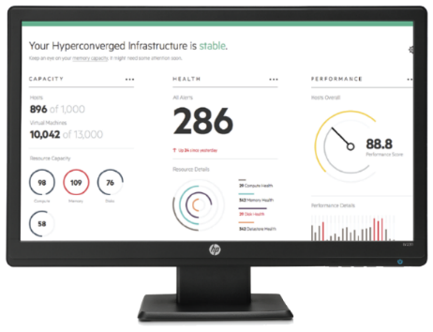

HPE Synergy unique innovations enable the composable experience
Private bare metal cloud ready to run any application and delivered as infrastructure as code
  Single Management Interface:
  One interface to discover, compose, update, and troubleshoot
  Frictionless Operations:
  Firmware and driver updates delivered seamlessly as one
  Unified API:
  Operations changes can be easily automated and Developers can program the infrastructure as code
  Image Streamer:
  Instantly provision operating environments on stateless infrastructure
  Template Based Composition:
  Templates composes the infrastructure to match the workload’s needs
  Developer Portal:
  Presents a private bare metal cloud through unified API & SDK

Slide 16
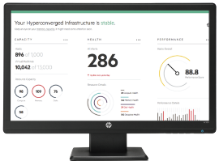
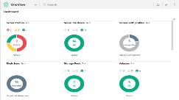

Transform datacenter efficiency with software-defined management
HPE OneView
Fast, simple, reliable, out-of-band firmware and driver updates
  Template based automation of infrastructure management
Eliminate silos across compute, storage and networking
Schedule firmware updates with infrastructure templates
Automate provisioning of 3PAR and StoreVirtual storage
Unified API transforms infrastructure into a single line of code
Single interface for up to 21 frames of compute, storage auto-discovery of all composable resources
Deploy, update, re-deploy physical machines like VMs with HPE Synergy Image Streamer
    73%
    Up to
    reduction in operator time performing firmware updates
Notes:
Claim: Up to 73% reduction in operator time performing firmware updates¹
Substantiation: ¹ HPE White Paper: HPE White Paper: The benefits of evolving your HPE BladeSystem environment to HPE Synergy based on HPE internal testing, April 2017.
http://h20195.www2.hpe.com/V2/GetDocument.aspx?docname=a00006129enw
Claim: 53% reduction in average software build time² with Docker container host
Substantiation: ² Clutch Cost to Build a Mobile App: A Survey + HPE internal tests, January 2015. Clutch surveyed representatives from 12 leading mobile application development companies to determine cost ranges of building an iPhone app and the key variables of cost. In our survey, we asked service providers to report the number of hours required to design and develop various features and aspects of mobile apps.

Slide 17




Precisely compose and recompose resources for each application
Only HPE
HPE Synergy Composer powered by HPE OneView
LIBRARY
Cloud Template
Image 4
Cloud Template
Image 4
Mobile Template
Image 2
Mobile Template
Image 2
Mobile Template
Image 2
Cloud Template
Image 3
Cloud Template
Image 3
ERP Template
Image 1
ERP Template
Image 1
Uninstall
Install
Install
A single interface to precisely compose and recompose resources for each application
Notes:
Let me show you how Synergy works …
First, Synergy self-discovers and assembles all resources: compute, storage, and fabric.
Next, it presents a catalogue of workload-based templates containing everything you need to deploy your infrastructure.
[need to change all of this to align with examples in slide]
For example, I have a banking app on my phone. For regulatory reasons, the bank runs the mobile back end for that app in their own datacenter. But they still need to deploy new services at cloud speed. Using Synergy, IT can quickly provision compute, storage, and fabric in minutes, and flex dynamically to the needs of that app. Let me show you how this is done.
[Docker app is dragged to management]
Let’s imaging that app is deployed using the open source tool, like Docker, The Docker workload template assembles compute nodes with a pool of storage in a container. I can scale compute and storage independently.[compute and storage callouts]
And when I no longer need this app, I can return the resources back to the resource pool. [Single line of code types in and levels change]
[MS SQL is dragged to management]
To deploy a traditional ,scalable database, Synergy instantly composes the high performance compute, with 3PAR storage. I designed this template with full redundancy for the highest availability. [fluctuating blue chart]
[More racks animate in]
What’s more, I can scale my workload across multiple racks—provisioning fluid resources to the needs of the entire enterprise. [Ends on branded Synergy lockup]

Slide 18
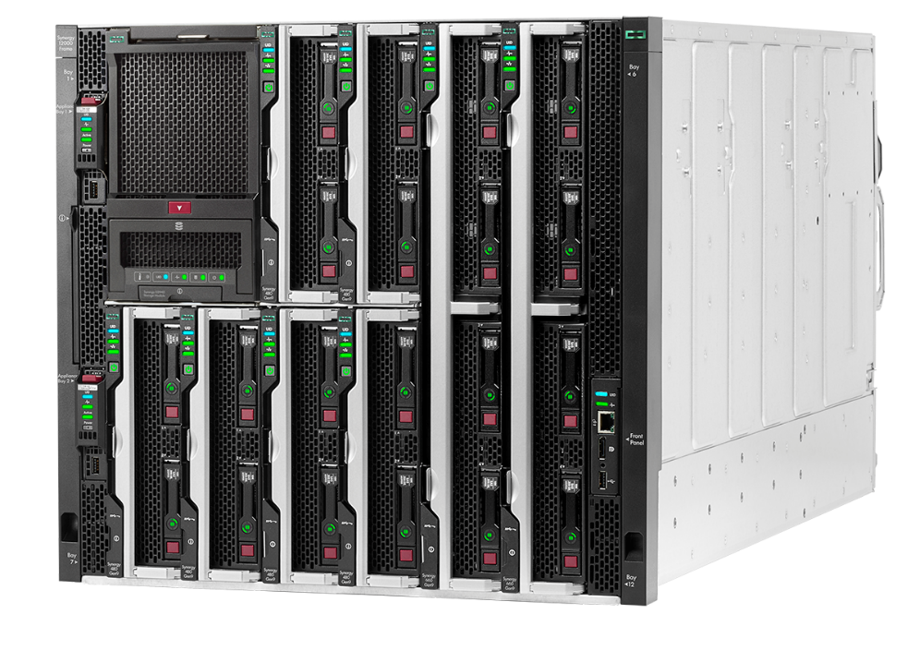
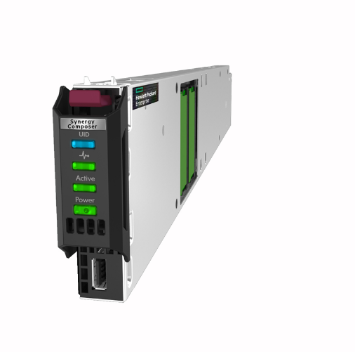




Instantly provision operating environments at the speed of cloud
HPE Synergy Image Streamer
Rapid, secure and cost-effective stateless operation
Compact, integrated image provisioning appliance
Highly available repository for bootable images
Redundant pair for up to 5 frames of compute modules
Automatically syncs images across multiple appliances
Superior alternative to PXE and boot from SAN
HPE Synergy Image Streamer
Seamless operation with Composer
Notes:
That’s the basic mgmt infrastructure of Synergy – gives you SDI with template based ops through a unified API scaled across mult frames
To accelerate the provisioning of OE to the speed of cloud - special purpose appliance
Same HW design as Composer that functions as a repository for bootable images that are integrated into template driven operations
Bootable images for different workloads in your environment stored and managed here.
Like Composer, highly available, cluster? And installed in any appliance bay
Pair for up to 5 frames
Faster, simpler and more secure than PXE and simpler and more cost-effective than boot from SAN
Transcription:
So that's kind of the core management of Synergy, the composer, and the manager ring. I talked about this appliance specialized appliance, the image streamer. And it's really one of the key parts of being able to drive this speed cloud to get to the hybrid kind of environment that you want. And it's really designed to allow you to like the public cloud providers be able to operate in a stateless environment. What it is again is appliance same hardware basically as the composer but to under optimizing storage and memory to be able to be a repository for images. And it's highly available and designed. You are going to be streaming the hypervisors operating systems from this to the computer devices so it is designed to be highly available you can install to these in up to five frames. They are really tied to the data fabric that we are going to talk about in a few minutes. So, if you had 20 frames, you might have up to four pairs of image streamers associated with each data fabric in that environment. In that situation you are going to have multiple instances so you're thinking about how I keep all those in sync. There is a primary pair and it syncs with the secondary pairs automatically so you know that all the images in each one are the same without any kind of manual intervention. So, what this does is give you a very simple and reliable and cost-effective way to build up to deliver build compute, build your infrastructure as well as get to a stateless environment. It's a great alternative to PXE. We packaged it as very simple to set up. You don’t have the security issues. A lot of companies don't let PXE on their networks for security reasons and it's much more cost-effective than boot from SAN. We've done a lot. People and tried to develop our put together iSCSI kind of boot environments in the past boot from SAN and it's complex but what we've done is taking all the complexity out of it and made it very simple.

Slide 19
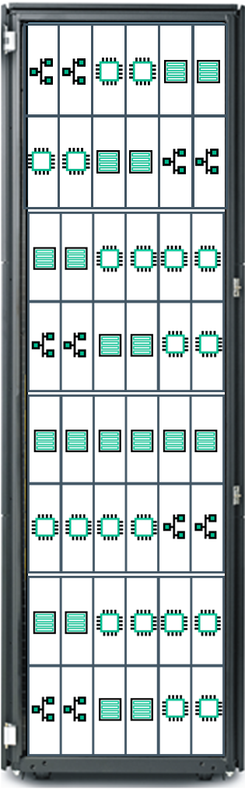
Instantly provision operating environments on stateless infrastructure
Traditional provisioning requires many steps and many reboots
Up to
80X faster
HPE Synergy
Traditional
HPE Synergy Image Streamer
Library of bootable images can be streamed across multiple compute modules in seconds
Library of Images
Image 2
Image content
Deployment/ Build plan
PXE/CD
Boot
Service OS
Install
OS
Reboot
Server
Customize
OS
Image 1
PXE/CD
Boot
Service OS
Install
OS
Reboot
Server
Customize
OS
PXE/CD
Boot
Service OS
Install
OS
Reboot
Server
Customize
OS
Reboot
Server
Install
App
Customize
App
Reboot
Server
Running
Server
Reboot
Server
Install
App
Customize
App
Reboot
Server
Reboot
Server
Install
App
Customize
App
Reboot
Server
Running
Server
Running
Server
Repeat for multiple servers
Repeat for multiple servers
Repeat for multiple servers
< 15 seconds
New images ready to boot
Notes:
“Traditional server deployment is a sequential process of building compute modules — physical provisioning, followed by provisioning an operating system, and then followed by provisioning a hypervisor installation. Traditional memory-based server deployments use general deployment/provisioning tools for ‘service OS’ deployment, which uses a RAM-based OS, and is also known as a ‘pre-boot (pre-install) environment’.
To accelerate workload deployment, HPE Synergy utilizes an Image Streamer, a repository of bootable images that can be streamed across multiple compute modules in a matter of seconds. This unique capability enables HPE Synergy to setup and update infrastructure with unmatched speed and consistency. This is significantly faster than the traditional, sequential process of building compute modules — physical provisioning followed by operating system or hypervisor installation. This is ideal for instances such as web scale deployments where IT needs to provision an Operating Environment across a large number infrastructure blocks.
Although both traditional approaches and the innovative HPE Synergy Image Streamer approach require image content in some form -- (like a ‘golden image’) and a deployment/build plan -- that is where the similarity ends. HPE Image Streamer accelerates workload deployment by utilizing a repository of bootable images that can be streamed across multiple compute modules at extreme speed. This unique capability enables HP Synergy to setup and update infrastructure with unmatched speed and consistency.
HPE Image Streamer also enables true ‘stateless’ operation by integrating your Server profiles with your golden images (OE and I/O driver) and your personalities (OS and application) for rapid implementation onto available hardware. The fast deployment and compliance management capabilities leverage software-defined intelligence and are accessible via the Unified API. These capabilities set HPE Image Streamer apart from traditional approaches.
Updates to highly-replicated physical compute modules with their operating environments at extreme speeds enables HPE Image Streamer to deliver fast virtualized image changeovers (for use in Test and Dev, DevOps, multiple PaaS) or secure boot and image compliance (for use in Defense, Government, or FSI). These capabilities are ideal for web scale deployments where IT needs to provision an operating environments across a large number infrastructure blocks.”

Slide 20
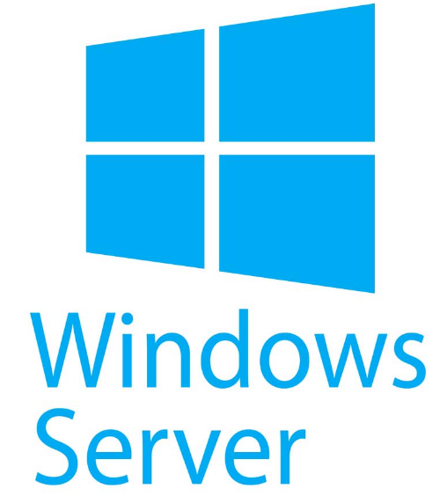
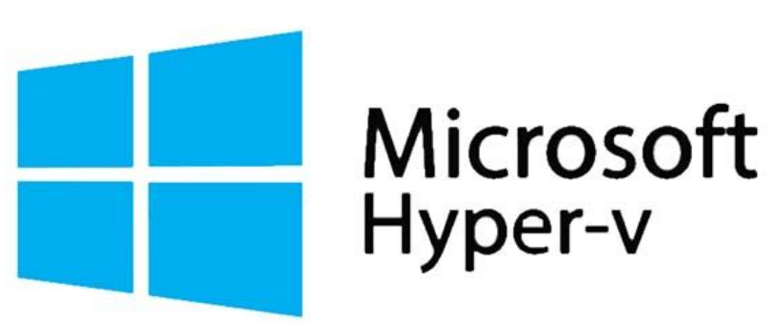
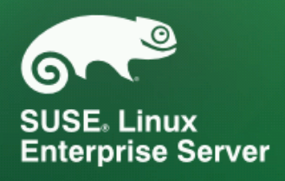
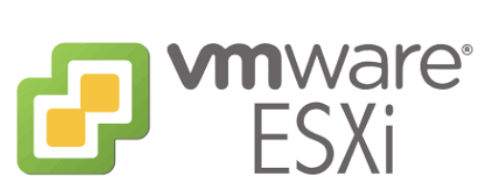

Windows support with Synergy Image Streamer
NEW
DevOps
engine
Cloud
engine
IT Ops engine
Microsoft Windows Server 2016 and Windows Hyper-V 2016 Server
Synergy integrated OS deployment solution
Reduce overprovisioning by switching workloads
Reduce CapEx with diskless servers
Slash service response time from hours to minutes
Popular workloads – HyperV, MSSQL, Exchange, VDI
Synergy Image Streamer
Operating Systems
*
Windows Artifacts go live Aug 1st 2018 week on HPE GitHub
Supported on Image Streamer 4.1
*
* EXT 3 & 4 filesystems only
Windows artifacts https://github.com/search?q=org%3AHewlettPackard+image-streamer&unscoped_q=image-streamer
Notes:
https://github.com/search?q=org%3AHewlettPackard+image-streamer&unscoped_q=image-streamer

Slide 21
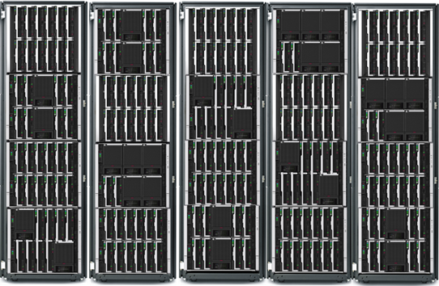
Seamlessly deliver updates without impacting operations
Only HPE
Frictionless operations reduce operational effort
HPE delivers tested and validated Firmware and Drivers as One
Automated delivery you control
Deploy quickly and confidently for continuous availability
Auto-stage
Deploy
Firmware/
Drivers
Seamlessly deliver firmware and driver updates without impacting operations
Notes:
Historically, change operations required coordination across multiple teams, multiple tools and complex interdependent processes that can often take weeks to complete. HPE Synergy abstracts away operational minutia replacing it with high-level, automated operations. Now, change operations such as updating firmware, adding additional storage to a service, or modifying network connectivity are automatically implemented via a template, significantly reducing manual interaction and human error. This empowers IT to configure the entire infrastructure for development, testing, and production environments using one interface and in one step with precision, accuracy, and speed.
Updating firmware for an entire HPE Synergy frame and every component inside can be done by a single administrator without disrupting operations. Compute module firmware and drivers are staged on and can wait to be activated during an application maintenance window, eliminating the need for any unique. This is a vast improvement over industry typical firmware updates, which requires managing many components, many of which require forced outages and manual sequencing of updates.

Slide 22

Scripting multiple API’s is complex and time consuming
Typical deployments require >50 scripts and 1000s of lines of code
Many APIs
50
hours
Update
Firmware
Update drivers
Set BIOS
settings
Set unique identifiers (WWN, SN, UUID, MAC)
Install OS, App/Hypervisor
Configure
smart array
Configure
network connectivity
Configure
SAN zoning
Configure
SAN
array
Infrastructure
Server
Network
Storage
to integrate a
third-party API
Clutch Cost to Build a Mobile App: A Survey
Notes:
Developers do not like waiting around for infrastructure to be available. Today do the initial build on average we have found that you need to write more the 50 scripts which add up to writing 1000’s of lines of code
And to incorporate a new tools like Docker or Chef, it requires in average of 50 hours integrate with infrastructure.
All slowing you down and worse yet, you need to maintain all these scripts and integrations.
. . . . .
Source: Clutch Cost to Build a Mobile App: A Survey January 2015
Clutch surveyed representatives from 12 leading mobile application development companies to determine cost ranges of building an iPhone app and the key variables of cost.
In our survey, we asked service providers to report the number of hours required to design and develop various features and aspects of mobile apps.
Third-party API Integration
Median range: 8 to 50 hours, Max value: 120 hours
Most apps use APIs to integrate a certain functionality or data set that a third party can provide. An API can be easier to cope with if it is well established, if the developer has utilized it before, especially if it's very common, if the documentation is detailed and up-to-date, or if it is included with a native SDK [software development kit]. High-quality third party support services can also make a difference in limiting the development time required.

Slide 23

HPE Composable API
Only HPE
Transforms infrastructure into a single line of code
Reduce time
to stand up
infrastructure from
50 hours
HPOVProfile -name$name, -baseline$base, -sanStorage$san, server$server –deployPlan$plan
to
minutes
Unified API.
DevOps Friendly.
Makes private cloud as simple as the public cloud.
Clutch Cost to Build a Mobile App: A Survey + HPE internal tests
Notes:
Today only HPE offers a Unified API (Compute, Storage and Fabric)
Increases productivity and control across the data center
Thru the unified API you can discover, search, inventory, configure, provision, update, and diagnose the composable infrastructure.
A single line of code eliminating time-consuming scripting of more than 500 calls to low-level tools and interfaces.
And the single line if code reduce the time to integrate new tool from hours to minutes
Unified API.
DevOps Friendly.
Makes bare metal private cloud as simple as the public cloud.
. HPE Synergy increases productivity and control across the data center by integrating and automating infrastructure operations and applications through a unified API. The unified API provides a single interface to discover, search, inventory, configure, provision, update, and diagnose the composable infrastructure. A single line of code fully describes and can provision the infrastructure required for an application, eliminating time-consuming scripting of more than 500 calls to low-level tools and interfaces.
In traditional environments, IT can now automate their IT operational processes and design their workflow around enterprise needs. For instance, IT can leverage the integration with HPE Operations Analytics to find the root cause of problems xx faster and more proactively.
For the new breed of applications, DevOps can now automate applications through infrastructure deployment, scaling, and updates. The unified API aggregates physical resources in the same way as virtual and public cloud resources, so developers can code without needing a detailed understanding of the underlying physical elements.
Does all of this :
· Updates firmware
· Sets BIOS settings
· Sets unique identifiers
(WWN, SN, UUID, MAC, WWN)
· Configures network connectivity
· Configures smart array
· Configures SAN zoning
· Configures 3Par array
Long version of traditional:
Updates firmware with HP SUM
Set BIOS settings with RCU
Sets unique identifiers (WWN, SN, UUID, MAC, WWN) with VCM/VCEM
Configures network connectivity with VCM/VCEM
Configures smart array with ACU
Configures SAN zoning with Brocade Switch Advisor
Configures 3Par array with 3Par IMC

Slide 24
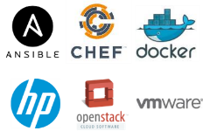

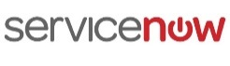
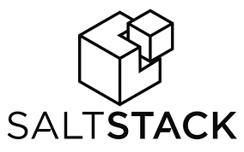


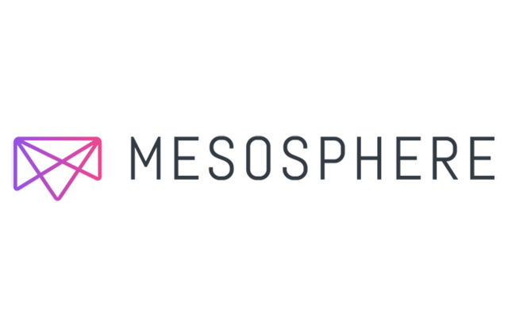


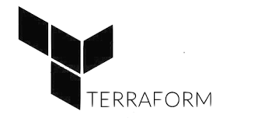













Deliver apps and services faster and easier
HPE composable ecosystem
DevOps
engine
IT Ops engine
Cloud
engine
Facilities
engine
Unified API
Software Defined Intelligence
Developer toolkits
Fluid Resource Pools
Powered by HPE OneView
www.hpe.com/info/composableprogram

Slide 25
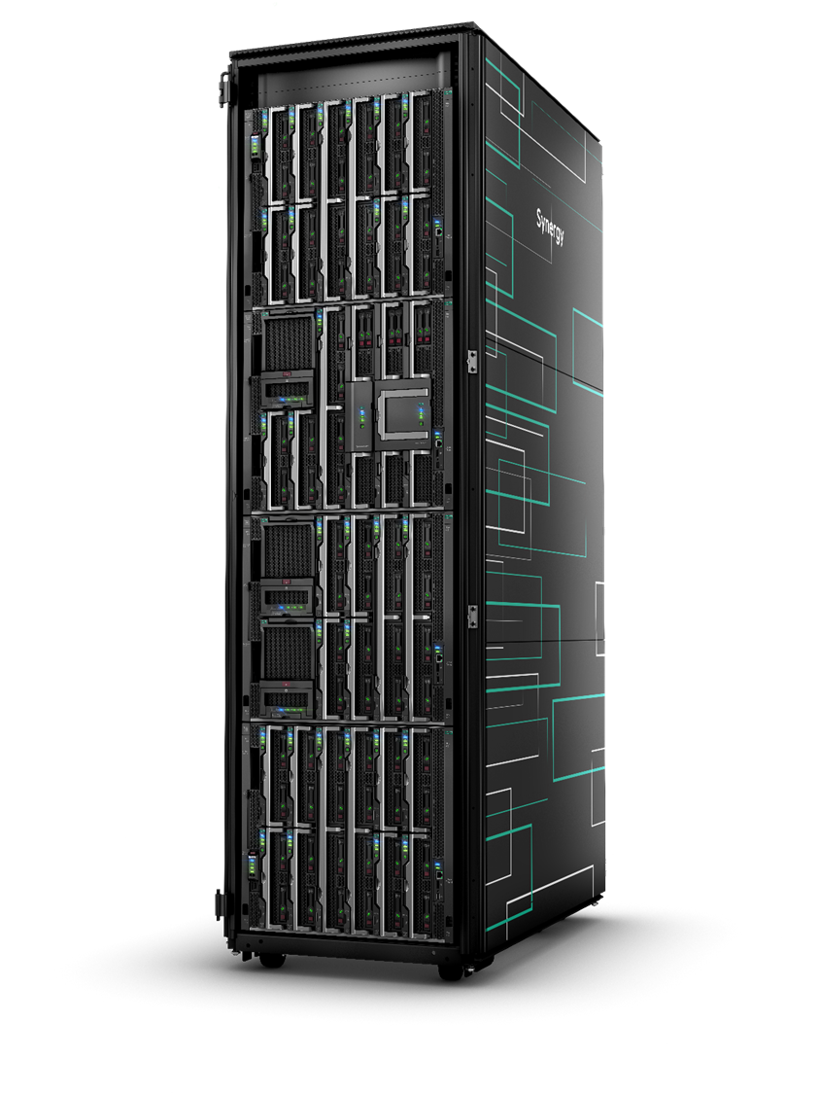
Transformational power of HPE Synergy
Single infrastructure for your traditional and cloud-native workloads
VDI / CAD applications run during the day
VDI
ANALYTICS
Modeling & Analytics
Run at night
SAP HANA
for running production mission-critical workloads
HANA
HANA
HANA
HANA
HANA
HANA
App Dev/Test environment
is needed now that peak season is over
DEV
DEV
DEV
TEST
TEST
and Oracle database
Oracle

Slide 26
Maximize your infrastructure utilization 7 x 24 x 365
Synergy solutions for Traditional and Cloud Apps
Traditional Enterprise
Cloud Native
Data Management
Collaboration
Virtualization and VDI
DevOps
Hybrid Cloud
    Accelerate Deployment
    Compose your infrastructure to match the needs of your data
    Oracle | SAP HANA | SQL
    Increase Flexibility
    Deploy apps quickly to optimize efficiencies
Exchange | SharePoint
    Optimize Infrastructure
    Ideal for VM farms, high density, and high graphic VDI demands
VMware | Oracle VM | Citrix
Fast Deployment
Deploy / ReDeploy quickly with an automated process
Docker | Chef | Puppet | Ansible | Mesosphere | Terraform | RH Openshift
Cost Effective
Run private cloud and traditional apps on shared infrastructure
Helion CloudSystem10
    Certs
    SAP HANA TDI Certified
    Oracle Linux Certified
    RAs/RCs
    Oracle 12c w/ DAS, RC
    Oracle 12c w/ 3PAR, RC
    Oracle 12c w/ Image Streamer, RA
    MS SQL 2016, RA
    MS SQL 2016, RC
    RAs/RCs
  MS Exchange 2013, RC
  MS Exchange & SharePoint 2016, RC
Certs
Oracle VM Certified
VMware vSAN Certified
RA/RC
Citrix XenDesktop, RC
RA/RC
Docker (EE) w/ Image Streamer, RC
    RA/RC
    Helion Cloud System 10, RA
    Top Performing Compute
    #1 - VMmark 2.x
    17 #1 - SPECjbb2015 Benchmark Scores

Slide 27
Economics of transforming your IT
How does HPE Synergy stack up?
41%
15%
50%
Lower cost / VM vs BladeSystem
Lower TCO vs Cisco UCS
Lower cost / VM vs AWS
Notes:
Comparing HPE Synergy Gen9 vs. BladeSystem Gen9 compare
HPE Synergy advantages vs. Cisco UCS based on HPE internal testing, April 2017.
Cisco UCS pricing and SKUs per Gartner Competitive Profiles, 03/2017. HPE pricing per HPE U.S. price list 03/2017. UCS configuration per UCS Spec sheets and Gartner Competitive Profiles 09/2016–03/2017. Pricing at net with 35% hardware and 42% support (HPE), 60% hardware, and 35% support (Cisco) discounts. Hardware discounts per Gartner Competitive Profiles; support discounts per HPE Technical Support.

Slide 28

Hear from customers who are transforming IT with HPE Synergy

Slide 29
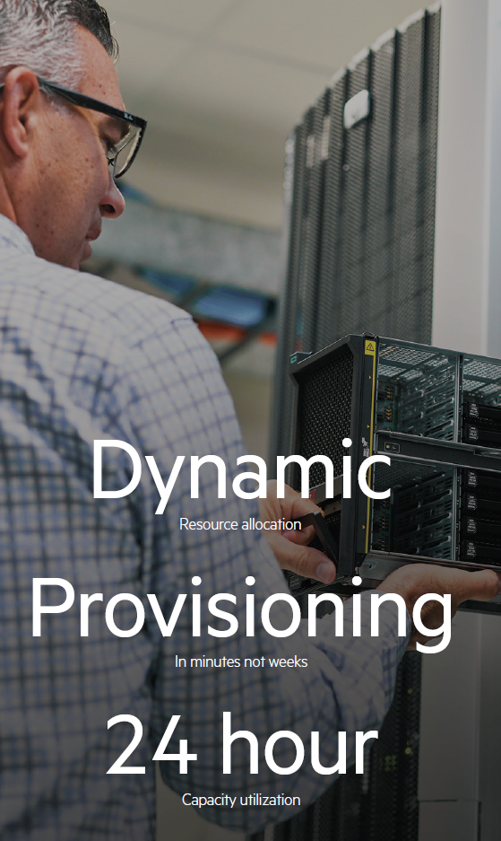
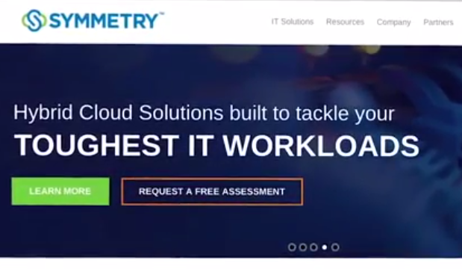



Customers are transforming IT with HPE Synergy
“With HPE Synergy I can see the whole composable infrastructure story, I can preview it, beta test it. Also, HPE has a holistic approach and understands that a solution is more than simply technology, it is about orchestrating and automating the different elements.”
Christian Teeft, CTO and Senior Vice President of Cloud Services, Symmetry
ROI of 247%
Payback in 13 months
43% lower hardware cost
94% faster delivery of compute resources
35% less server-related help desk work
Six times higher coding team productivity with DevOps approach
1400
and growing
“Implementing HPE Synergy has removed obstacles to our growth. We were limited by space and we were limited by the time needed to deploy new servers but all that has gone. Now we can just grow and grow with no limits. We allocate space in the Bechtle data center, we buy new frames, put them in and then deploy new servers.”
Stephan Dangl, Team lead for Servers, Storage and virtualization, Bechtle Hosting & Operations GmbH

Slide 30

HPE Synergy optimizes workloads for leading genome researcher
Implements a robust platform for life-saving research
Researcher’s work is highly data intensive and requires a robust and versatile platform to manage and analyze the data
HPE Synergy:
  Reduces resource revisions for whole human genome analysis workloads to seconds
  Streamlines life-saving work by increasing the speed and volume of data being studied
  Reduces resource re-provisioning times from 4 days to 2 hours
  Enables IT infrastructure to be swiftly adjusted to meet workload needs
  Increase storage capacity and reduces cost-per-terabyte
  Enables scientists to build their own programs, further speeding the diagnosis process

Slide 31

HPE Synergy creates scale and agility to manage rapid growth
Future proofs Symmetry’s infrastructure investments
HPE Synergy:
  Allows Symmetry to create multi-tenancy environments with a single platform, with distinct SLAs for different customers
  Delivers the scale, availability and technology roadmap to underpin future growth
  Creates granular visibility of customers’ platform usage; raising customer experience expectations
  Improves the ability to automate and orchestrate process; dramatically lifting operational efficiency
  Ensures access to support expertise, improving customer delivery and reducing downtime

Slide 32
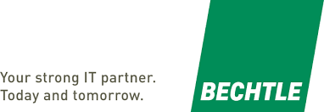
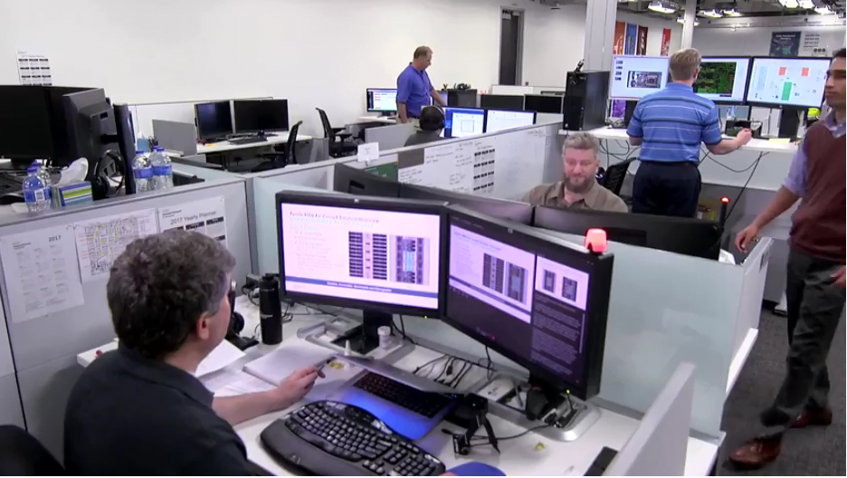
HPE Synergy slashes server deployment times to underpin growth
Upgrades customer offering and streamlines internal platform management
HPE Synergy:
  Reduces infrastructure provisioning time from nine hours to 55 minutes
  Supports delivery of new services
  Reduces cost of hardware over-provisioning and network investment
  Delivers the scale, availability and technology roadmap to underpin future growth
  Lowers wages bill by enabling unmanned data centers
  Delivers a scalable infrastructure foundation for business growth

Slide 33
HPE Synergy
Your Infrastructure as Code
Run anything
Reduce CapEx and free resources
Move faster
Deploy at cloud-like speed
Work efficiently
Simplify with frictionless operations
Unlock value
Develop more app faster
Notes:
HPE Comments 11/7
Like the slide, but may not fit in flow – this was the Vision slide. Need to think
- - - - -
Key point: The idea economy puts new demands on IT infrastructure. You now need an infrastructure that empowers IT to create and deliver new value instantly and continuously.
Composable Infrastructure, offers an experience that empowers IT to create and deliver new value instantly and continuously enabling IT to:
Run anything: Optimize all apps and service levels
Optimize any application and store all data on a single infrastructure with fluid pools of physical and virtual compute, storage, and fabric.
Move faster: Accelerate app and service delivery
Accelerate application and service delivery through a single interface that precisely composes logical infrastructures at near-instant speeds.
Work efficiently: Reduce operational effort and cost
Reduce operational effort and cost through internal software defined intelligence with template driven, frictionless operations.
Unlock value: Increase productivity and control
Increase productivity and control across the data center by integrating and automating infrastructure operations and applications through a unified API.
Technical description of Infrastructure as code
Provision bare metal infrastructure with one line of code – in the same way as virtual machines and cloud

Slide 34
HPE Pointnext

Slide 35


Easy migration from your existing blade infrastructure
HPE Rapid Advisory for Synergy
Overview
Two day, HPE Pointnext lead workshop
Deployment plan for Synergy
Buy-in from your stakeholders
Key Focus Areas
What workloads
How to integrate
Business drivers and key success factors
Identification of road blocks
Notes:
Overview
Two day, TS Consulting lead workshop with your key stakeholders and HPE technology consulting teams. The service offers deployment plan for Synergy and buy-in from your stakeholders for deployment
Benefits
Shared vision among all stakeholders in your organization
Identification of road blocks
Recommendations from senior HPE experts
Agreement on:
What workloads
How to integrate with management, monitoring, orchestration/ automation and security tools
Business drives and key success factors
Faster time to production operation of HPE Synergy

Slide 36

Enhance your deployment team’ s productivity
HPE Image Streamer Implementation service
Overview
Knowledge transfer on how to configure Synergy Image Streamer
On-site briefings
  Image Streamer, image design
  Best practices, troubleshooting
Key Focus Areas
Establish a ready-to-use Image Streamer
Provide deployable images
Demonstrate operations
Addresses specific application stacks and images
Transfer knowledge
Notes:
Configure and demonstrate Synergy Image Streamer
On-site briefings
Image Streamer
Image design
Best practices
Troubleshooting
Delivered on site
5 days duration
Establishes a ready-to-use Image Streamer with deployable images
Demonstrates operations with a walk-through of processes
Provides multiple working samples on which deployment team can build
Transfer knowledge
Addresses specific application stacks and images

Slide 37
HPE GreenLake Flex Capacity
Flexibility in how you consume your HPE Synergy resources
Infrastructure capacity that never runs out
Scalable – add capacity in minutes from buffer on site
Pay only for what you use
Align costs with usage monthly via advanced metering
No upfront payment requirements
Your choice of technology
Enterprise-quality support
Hybrid with Microsoft Azure
Business application
Increase capacity
Forecasted
capacity
pay only for
what you use
Local buffer
Decrease capacity
Notes:
Here are optimum scenarios when HPE GreenLake Flex Capacity might well be the right solution for you.
When large capital outlays and long procurement cycles no longer fit your business – when you want to pay for what you use
When your data and workloads must stay on-premises, under your control
For workloads that could expand to public cloud – under the right controls and for the right workloads
When you need better than “best effort” SLAs
HPE GreenLake Flex offers smooth and cost-effective capacity growth – With the headroom for peak processing periods such as quarter or year-end processing. Our concept gives you a detailed view of the expenses associated with your IT infrastructure, allowing you to achieve IT flexibility at reduced costs. With a cost model that makes sense, you can deliver true agility.
Flexible capacity, as quick as it gets
Increase or decrease capacity, quickly and easily. You can acquire new capacity quickly because you’ll have an incremental buffer available on site at all times. This buffer can be replenished through our service agreement without the need to initiate a full procurement cycle. HPE absorbs a significant share of your business risk by installing capacity ahead of the demand. We continually enhance the existing capacity, enabling sufficient standby capacity. Whatever your loads are, we can provide the resources you need, when you need it. When you no longer have use for the additional capacity, you don’t have to pay for it. You can just turn it off until you need it again.

Slide 38

Operate your HPE Synergy environment effectively
Operational support services and Factory Express
Overview
Ready-to-production HPE Synergy solution
Problem prevention
Superior call experience for HPE Synergy devices
Key Focus Areas
Factory pre-integration of discrete components
Direct access to Advanced Solution Center
Tailored, proactive reports
Start to finish Case Ownership
Multiple service levels

Slide 39
Thank you

